Slide 1
DBMS and
RDBMS

Slide 2
Data and Database
Data means any raw facts. And Information is the collection of related data.
Data means information and it is the most important component in any work that is done.
A database is a collection of data.
Thus, a database is a collection of data that is organized such that its contents can be easily accessed, managed, and updated.
Stores Information
Database
Users
Allows to Access Information

Slide 3

Data Management
Data management deals with managing large amount of information, which involves both the storage of information and the provision of mechanisms for the manipulation of information.
The two different approaches of managing data are:
  File-based systems
  Database systems

Slide 4

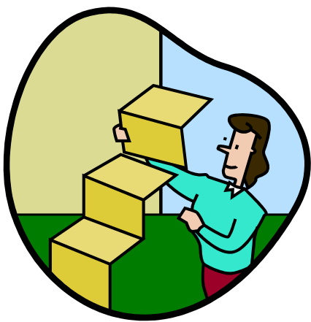

File-based systems 1-3
Features of file-based systems:
Systems in which data was stored
in discrete files.
In this system, a bunch of files was stored on a computer and could be accessed by a computer operator.

Slide 5

File-based systems 2-3
Example
The Sales database will contain the following tables:
  PropertyForRent (PropertyNo, Address, Type, Rent, OwnerNo)
  PrivateOwner (OwnerNo, Name, Address, TelNo)
  Client (ClientNo, Name, Address, TelNo, PrefType, MaxRent)
Sales
Database
Data entry and reports
File handling routines

Slide 6


File-based systems 3-3
Disadvantages of File-based Systems are:
  Data Redundancy and Inconsistency
  Unanticipated Queries
  Data Isolation
  Concurrent Access Anomalies
  Security Problems
  Integrity Problems

Slide 7
Database systems
Databases are used to store data in an efficient and organized manner, which allows quick and easy management of data.
Advantages of database systems are:
  The amount of redundancy in the stored data can be reduced
  No more inconsistencies in data
  The stored data can be shared
  Standards can be set and followed
  Data Integrity can be maintained
  Security of data can be implemented

Slide 8
Database Management System (DBMS) 1-2
It is a collection of related records and a set of programs that access and manipulate these records.
DBMS provides an environment that is both convenient and efficient to use when there is a large volume of data and many transactions to be processed.
It enables the users to define, create, and maintain the database and provides controlled access to this database.
Different DBMS support different query languages, although there is a semi-standardized query language called SQL (Structured Query Language).

Slide 9
Benefits of DBMS
The benefits of typical DBMS are as follows:
  Data Storage
  Data Definition
  Data Manipulation
  Data Security and Integrity
  Data Recovery and Concurrency
  Performance
  Database Access Languages and Application Programming Interfaces

Slide 10
Database Models 1-5
Databases can be differentiated based on functions and model of the data.
A data model describes a container for storing data, and the process of storing and retrieving data from that container.

Slide 11



Database Models 2-5
- Hierarchical model
- Network model
- Relational model

Slide 12



Database Models 3-5
The different types of data models are:
  Flat-file Data model
    This model is used for simple databases. The database consists of only one table or file.
  Hierarchical Model
    Records are inter-related through hierarchical or tree-like structures.
    In this model, relationships are thought of in terms of children and parents. A parent record can have several children, but a child can have only one parent.

Slide 13
Database Models 4-5
  Network Data Model
    It is similar to the Hierarchical Data Model.
    The hierarchical model is actually a subset of the network model.
    The network model uses set theory to provide a tree-like hierarchy with the exception that child tables were allowed to have more than one parent.
    Data is stored in sets, instead of the hierarchical tree format. This solves the problem of data redundancy.

Slide 14
Database Models 5-5
  Relational Data Model:
In the Relational Model, there are no physical links. All data
is maintained in the form of tables consisting of rows and
columns.
Data in two tables is related through common columns.
Operators are provided for operating on rows in tables.
This model represents the database as a collection of
relations. In this model’s terminology, a row is called a
tuple, a column an attribute and the table is called a
relation. The list of values applicable to a particular field is
called domain.

Slide 15
Relational Database Management System (RDBMS)
A Relational Database Management System (RDBMS) is a database management system where all data visible to the user is organized strictly as tables of data values, and where all database operations take place on these tables.
A relational database is a database divided into logical units called tables, where tables are related to one another within the database.
Relationship
TABLE 1
Key
Data...
TABLE 2
Key
Data...
Database

Slide 16
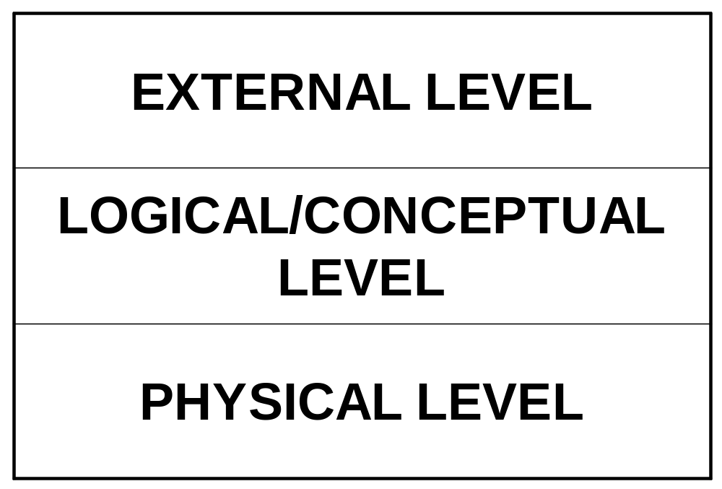
Layered database architecture
Notes:
External Level: It is the individual user level. The user may be an application programmer or an end user. Use of a data sublanguage is required.
It is represented by views.
Conceptual/Logical Level – It contains the representation of data. This view represents the data as it really is which is different from the external level in the sense that at the external level the users are forced to see the data imposed by some restrictions.
Physical Level – It’s a low level representation of the entire database. Consist of the actual files where the data is stored. Generally it is to be dealt by only the DBA.

Slide 17
Terms related to RDBMS
Term | Meaning
Relation | A table
Tuple | A row or a record in a relation
Attribute | A field or a column in a relation
Cardinality of a relation | The number of tuples in a relation
Degree of a relation | The number of attributes in a relation
Domain of an attribute | The set of all values that can be taken by the attribute

Slide 18
These terms are mostly used in RDBMS:
  Data is presented as a collection of relations.
  Each relation is depicted as a table.
  Columns are attributes.
  Rows (“tuples”) represent entities.
  Every table has a set of attributes that are taken together as a “key” (technically, a “superkey”), which uniquely identifies each entity.

Slide 19
Keys
A key is an attribute (also known as column or field) or a combination of attribute that is used to identify records.
Super Key – An attribute or a combination of attribute that is used to identify the records uniquely is known as Super Key.

Slide 20
Continue...
Candidate Key – It can be defined as minimal Super Key or irreducible Super Key. In other words an attribute or a combination of attribute that identifies the record uniquely but none of its proper subsets can identify the records uniquely.

Slide 21
Continue...
Primary Key – A Candidate Key that is used by the database designer for unique identification of each row in a table is known as Primary Key.
On single table we can create only one primary key.
Primary key will not allow duplicate as well as null value.

Slide 22
Continue...
Foreign Key – A foreign key is an attribute or combination of attribute in one base table that points to the candidate key (generally it is the primary key) of another table or same table.
Foreign Key allow duplicate record but only those record which present in primary key.
It allow null value.

Slide 23
Continue...
Composite Key – If we use multiple attributes to create a Primary Key then that Primary Key is called Composite Key (also called a Compound Key or Concatenated Key).
Alternate Key – Alternate Key can be any of the Candidate Keys except for the Primary Key.

Slide 24
Continue...
Secondary Key – The attributes that are not even the Super Key but can be still used for identification of records (not unique) are known as Secondary Key.
Surrogate key: : It is created to be the record’s primary key identifier when no suitable primary key exists. In an Oracle database, you can automatically generate surrogate key values using a sequence.

Slide 25
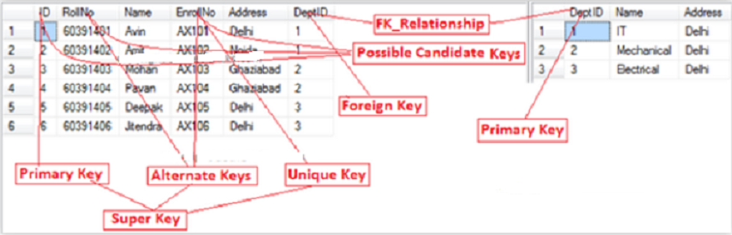

Slide 26


Users of RDBMS
Database
Administrators
End Users
Application Programmers

Slide 27



The E-R Model(1)
It is a ‘conceptual model’ of the database
Here, a system is composed of related entities
Tables identified
Database Designer
End User

Slide 28






Components of E-R Model
Entity
Attributes
A description
A Property
Relationship

Slide 29
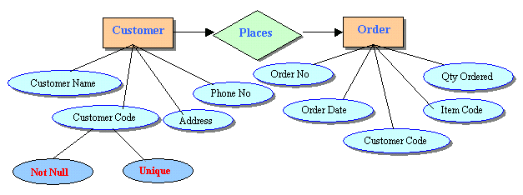
Entity Relationship Diagram
Entity
Attribute
Relationship

Slide 30
Entities and Tables
An entity is a person, place, thing, object, event, or even a concept, which can be distinctly identified.
Each entity has certain characteristics known as attributes and each entity set is given a name.
A table contains a group of related entities called an entity set.
The terms entity set and table are often used interchangeably. A table is also called a relation, rows are known as tuples and columns are known as attributes.
EMPLOYEE

Slide 31
Table
Attributes
Emp_No | Emp_Name | Emp_DOB | Emp_DOJ
345 | James | 24-Sep-1968 | 30-May-1990
873 | Pamela | 27-Jul-1970 | 19-Nov-1993
693 | Allan | 10-Sep-1970 | 01-Jul-1992
305 | Geoff | 12-Feb-1973 | 29-Oct-1996
Tuple

Slide 32
Difference between DBMS and RDBMS
DBMS | RDBMS
It doest not need to have data in a tabular structure nor does it enforce tabular relationships between data items. | In RDBMS, tabular structure is a must and table relationships are enforced by the system. These relationships enable the user to apply and manage business rules with minimal coding.
Small amount of data can be stored and retrieved. | RDBMS can store and retrieve large amount of data.
DBMS is less secure than RDBMS. | DBMS is less secure than RDBMS.
It is a single user system. | It is a multiuser system.
Most DBMSs do not supporting client/server architecture. | It supports client/server architecture.

Slide 33
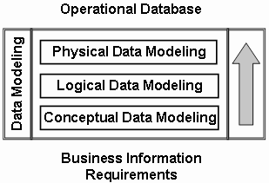
Data Modeling
Data Model - a group of conceptual tools that describes data, its relationships and semantics. It also consists of the consistency constraints that the data adheres to.
Data modeling can be broken down into three broad steps:
  Conceptual Data Modeling
  Logical Data Modeling
  Physical Data Modeling

Slide 34
Entity-Relationship (ER) model 1-4
Data models can be classified into three different groups:
  Object-based logical models
  Record-based logical models
  Physical models
The Entity-Relationship (E-R) model belongs to the first classification. The model is based on a simple idea. Data can be perceived as real world objects called entities and the relationships that exist between them.
An E-R model consists of five basic components. They are:
  Entity
  Relationship
  Attributes
  Entity Set
  Relationship Set
Employee Entity Set
Department Entity Set
€
€
€
€
€
Relationship Set
€
Human Resource
€
€
€
€
works in
Production
€
€
€
€
€
Accounts
Logistics
Department Entities
Employee Entities

Slide 35
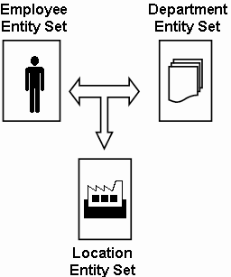
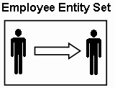
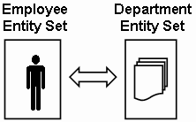
Entity-Relationship (ER) model 2-4
Relationships associate one or more entities. They can be of three types:
  Self relationships: Relationships between entities of the same entity set are called self relationships.
  Ternary relationships: Relationships that exist between three entities of different entity sets are called ternary relationships.
  Binary relationships: Relationships that exist between entities of two different entity sets are called binary relationships.

Slide 36
Entity-Relationship (ER) model 3-4
Relationships can also be classified as per mapping cardinalities. The different mapping cardinalities are:
  One-to-One: This kind of mapping exists when an entity of one entity set can be associated with only one entity of another set.
  One-to-Many: This kind of mapping exists when an entity of one set can be associated with more than one entity of another entity set.
Vehicle Entity Set

Vehicle Entity Set
 
 
 
Registration Entity Set
Customer Entity Set

 
€
 
 
registration


Slide 37
Entity-Relationship (ER) model 4-4
  Many-to-One: This kind of mapping exists when many entities of one set is associated with an entity of another set. This association is done irrespective of whether the latter entity is already associated to other or more entities of the former entity set.
  Many-to-Many: This kind of mapping exists when any number of entities of one set can be associated with any number of entities of the other entity set.
Vehicle Entity set

 
 
 
Location Entity set
Customer Entity Set
Account Entity Set

€
 
☞
€


Slide 38
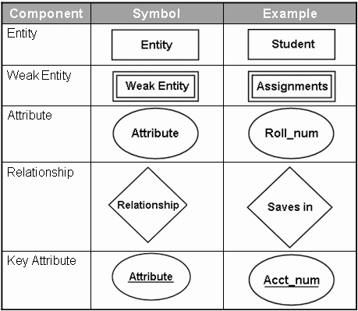
Entity-Relationship Diagrams
The E-R diagram is a graphical representation of the E-R model.
The symbols used for the various components can be seen in the following table:

Slide 39
Entity-Relationship Diagrams
Steps to construct an E-R diagram are:
  Gather all the data that needs to be modeled.
  Identify data that can be modeled as real world entities.
  Identify the attributes for each entity.
  Sort entity sets as weak or strong entity sets.
  Sort entity attributes as key attributes, multi-valued attributes, composite attributes, derived attributes.
  Identify the relations between the different entities.
  Using the different symbols draw the entities, their attributes and their relationships. Use appropriate symbols while drawing attributes.

Slide 40
Creating Tables - Normalization
  Points to Note
  Well defined relationship between tables
  Unnecessary or redundant data kept away.
  Group related data
  Achieved through a technique called ‘Normalization’

Slide 41
First Normal Form
Rule 1: Eliminate Repeating Groups
First Normal Form
Puppy
Puppy Number(pk) Puppy Name Kennel Code Kennel Name Kennel Location
Un-Normalised Data Items for Puppies
Puppy number
Puppy name
Kennel Code
Kennel Name
Kennel location
Trick ID 1...n
Trick Name 1...n
Trick Where Learned 1...n
Skill Level 1...n
Trick
Puppy Number(fk)
Trick Id(pk)
Trick Name
Trick Where Learned Skill Level

Slide 42
Second Normal Form
Rule 2: Eliminate Redundant Data
Second Normal Form
Puppy
Puppy Number
Puppy Name
Kennel Code
Kennel Name
Kennel Location
Puppy Tricks
Puppy Number
Trick ID
Trick Where Learned
Skill Level
Tricks
Trick ID
Trick Name
No Update or Delete Anomalies

Slide 43
Third Normal Form
Rule 3: Eliminate Columns Not Dependent On A Key
Third Normal Form
Puppies
Puppy Number
Puppy Name
Kennel Code
Puppy Tricks
Puppy Number
Trick ID
Trick Where Learned
Skill Level
Kennel
Kennel Code
Kennel Name
Kennel Location
Trick
Trick ID
Trick Name

Slide 44
Characteristics of a normalized database
Each table must have a key field
All fields must contain small data
There must be no repeating fields
Each table must contain information about a single entity
Each field in a table must depend on the key field
All non-key fields must be mutually independent

Slide 45
When to use Normalization??
When data is large and scattered
There is no defined group of data
Data is too complicated
The first step to build the database application

Slide 46
Denormalisation
Normalization has some drawbacks.
Joins with multiple tables affects the performance of the database. The CPU time required to solve such queries will be very large. In such cases, storing a few fields redundantly can be considered to increase the performance of the database. Such a database is said to be a Denormalised database.

